Slide 1

STATISTICS AND PREDICTIVE MODELLING
FINAL PROJECT – DATA 1204
SUBMITTED BY :
SHYAM PURUSOTH PARTHASARATHY (100847344)
SUBMITTED TO :
PROFESSOR RITWICK DUTTA
DATE :
12/14/2021

Slide 2
Description:
Mr. John Hughes is trying to predict household expenses based on personal attributes.
The personal attributes include age, sex, BMI, Number of children, Smoking habits and region of residence.
Additionally, Mr. John Hughes is also trying to understand how specifically smoking habits has an effect on household expenses.
To help Mr. John Hughes, we will be performing Linear regression to find the effect of smoking habits on household expenses.
Furthermore, we will also perform Multivariate regression to predict hoe all the other personal attributes has an effect on house hold expenses.

Slide 3
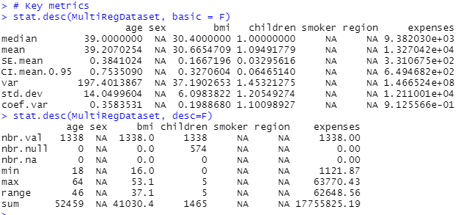
Statistics of Data:
Based on Data, The average age of a person in household is 39.2. Moreover, the mean and median age of person in household is almost same.
Also, the minimum and maximum age of person in household is 16 and 64 respectively.
The standard deviation for age is 14.04 which shows the age of people are quite spread out.
Additionally, the average BMI of a person in the house is 30.66. This proves most of the people in the dataset are overweight.
Similar to Age, the mean and median value of BMI is almost same.
The standard deviation of BMI is 6.094 which shows the BMI of people in household belong to two or three categories such as underweight, overweight, obese etc.
Furthermore, the minimum and maximum BMI of a person is 16 and 53.1 respectively.

Slide 4
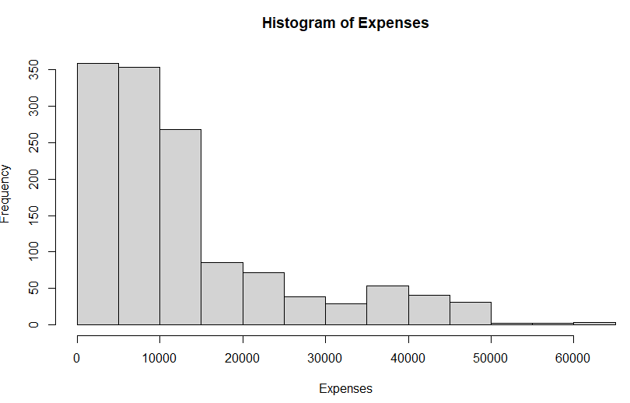
Histogram :
Based on histogram, we can see that most of the houses has expenses between 0 to 15000.
On a contrary, only a few houses has expenses more than 50,000.

Slide 5
Hypothesis Statement:
HYPOTHESIS STATEMENT:
NULL HYPOTHESIS :
H_{O}= The mean of expenses is equal to 10000.
ALTERNATE HYPOTHESIS:
H_{a}= The mean of expenses is not equal to 10000.

Slide 6
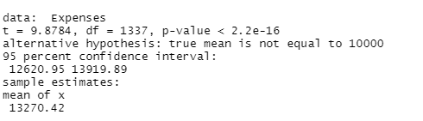
T-Test Results
The P-Value of the t-test is less than 0.05.
Therefore, we can reject the null hypothesis which is mean is equal to 10,000.
Hence, we accept the alternate hypothesis which is mean value is not equal to 10,000.

Slide 7
Hypothesis Statement ( Linear Regression):
HYPOTHESIS STATEMENT:
NULL HYPOTHESIS :
H_{O} : β=0, co-efficient β (smoker variable coefficient) of the predictor is zero and not statistically significant.
ALTERNATE HYPOTHESIS:
H_{a} : β ≠0, co-efficient β (smoker variable coefficient) of the predictor is not equal to zero and is statistically significant.

Slide 8
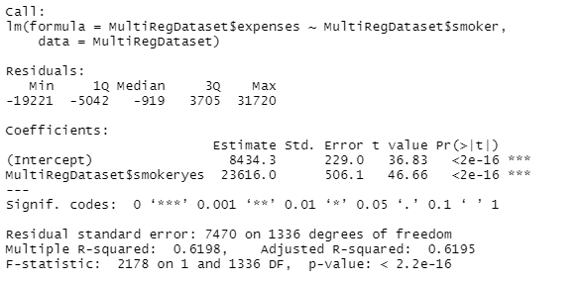
Linear Regression Model (Interpretation):
Linear Regression Equation:
Expenses = 8434.3 + 23616(Smoker)
The P-value of Linear regression model is 2.2e-16 which is very less than our significance level 0.05.
Therefore, we reject the null hypothesis which states co-efficient β (smoker variable coefficient) of the predictor is zero and not statistically significant.
Hence, we accept the alternate hypothesis which is β ≠0, co-efficient β (smoker variable coefficient) of the predictor is not equal to zero and is statistically significant

Slide 9
Linear Regression (Evaluation):
The Median value of residual is less than third quartile but greater than first quartile. Therefore, residuals are approximately normally distributed.
The value of R-squared is 0.6198 approximately 0.62. This indicates the model can explain 62% of variability in data.
Since the R squared value is lesser than expected, further investigation on this model might be required.

Slide 10
Hypothesis Statement (MLR):
HYPOTHESIS STATEMENT:
NULL HYPOTHESIS :
H_{O}= All the independent variables are not correlated to predictor variable (Household Expenses).
ALTERNATE HYPOTHESIS:
H_{a}= All the independent variables are correlated to predictor variable (Household Expenses).

Slide 11
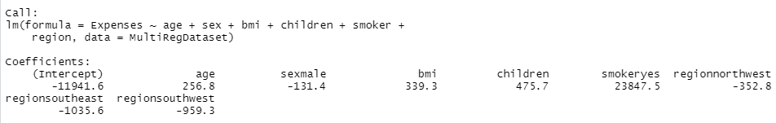
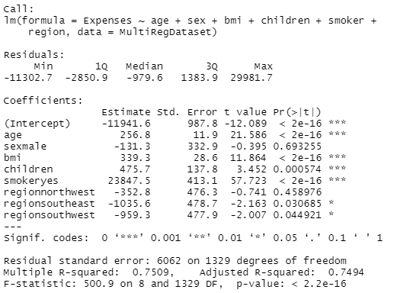
Multi Linear Regression Model:
Multi Linear Regression Equation:
Expenses = -11941.6 + 256.8(Age) -131.3 (Sex) + 339.3(BMI) + 475.7 (Children) + 23847.5 (Smoker) + (-352.8 – 1035.6 -959.3) Region
The value of P is 2.2e-16 which is almost zero.
Since the P-value is less than 0.05 , we can reject null hypothesis which states all the independent variables are not correlated to predictor variable (Household Expenses).
Therefore, we accept the alternate hypothesis which states that all the independent variables are correlated to predictor variable (Household Expenses).

Slide 12
Multi Linear Regression (Interpretation and Evaluation):
The median value of residuals is -979.6 which is less than minimum and first quartile value of residuals.
Therefore, the residuals are normally distributed.
Additionally, except the P values of variables sex and region all the other independent variable has P-value lesser than 0.05.
Also, the value of adjusted R squared is 0.7494 which indicates that the model is able explain 75% (approx.) variability in data and the model’s performance is great.
Hence, the model can be used in live for further predictions.

Slide 13
Conclusion:
Predicting the expenses only using Smoking habits only explains 62% variability in data . Hence, the performance of simple linear regression model may not be up to the expected level.
However, including other independent variables in data gives the adjusted R squared value as 75% which shows it can explain 75% of the variability in data.
Therefore, the performance of Multi linear regression model has exceeded the performance of linear regression.
To increase the performance of multi linear model, we can remove the correlation ship between independent variables.
Additionally, we can also remove some variables which does not contribute to model’s performance and create the model.
Overall, I recommend Mr. John Hughes to use the multi linear model to predict the household expenses.

Slide 14
APPENDIX:
# Load Libraries
library(ggplot2)
library(dplyr)
library(openintro)
library(pastecs)
# View dataset
View(MultiRegDataset)
# View first few lines of dataset
head(MultiRegDataset)
# View structure of datset
str(MultiRegDataset)
# Key metrics
stat.desc(MultiRegDataset, basic = F)
stat.desc(MultiRegDataset, desc=F)

Slide 15
APPENDIX:
# Histogram
Expenses = MultiRegDataset$expenses
hist(Expenses)
# Two tailed Test
t.test(Expenses, mu=10000)
#Build Simple Linear Model
simple.fit = lm(MultiRegDataset$expenses~MultiRegDataset$smoker, data=MultiRegDataset)
LinearModel= simple.fit
#Summary of Key Statistics of the Model
summary(LinearModel)
print(LinearModel)
#Build Multi linear Model
model <- lm(Expenses~ age + sex +bmi + children + smoker + region, data = MultiRegDataset)
# Print and summary of the model.
print(model)
summary(model)

Slide 16

THANK YOU

